Slide 1
Implementation of D* Lite
Elijah Cadenhead
Andrew Helms
Daniel King

Slide 2
Problem Formulation
Goal: Implement the D* lite path-planning algorithm to find a path through a partially unknown or dynamic environment.
Project Components:
Create GUI and environment. Be able to change the environment while the algorithm is running.
Implement A*, Lifelong Planning A*, and D* Lite to search this environment
We are starting with a A*star implementation that will use a straight line heuristic to find the shortest path.
uses NN from https://github.com/artest08/LateTemporalModeling3DCNN

Slide 3
Description of progress of the subtasks(each member)
Eli has implemented a GUI using SFML to display the map we will be running the algorithms on
Andrew has implemented the A* algorithm along with our GitHub set up
Daniel has done research on creating the A* algorithm and heuristics to use along with the check in presentation slides
Our main task, implementing D* Lite, hasn’t been completed. We are first implementing A* star then Lifelong Planning A* followed by D* Lite as they each build off of each other

Slide 4
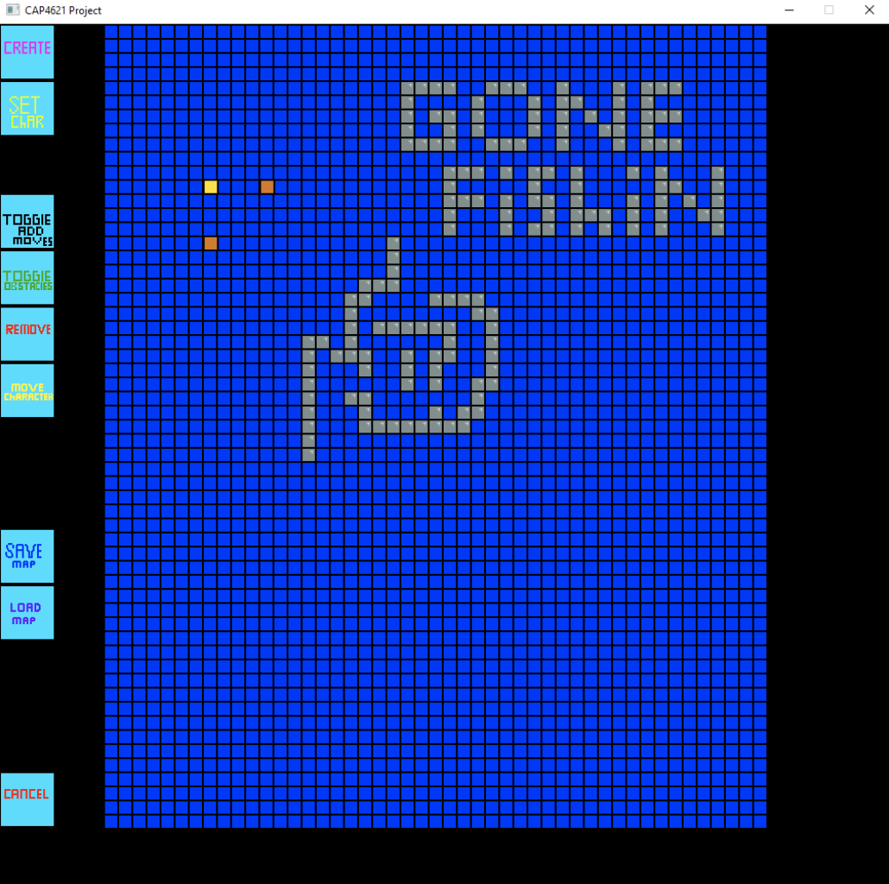
Provide the links to your deliverables/artifacts (files with code or design diagrams)
Important Links:
GitHub: https://github.com/andrew-helms/Pathplanner
Research Papers:
http://idm-lab.org/bib/abstracts/papers/aaai02b.pdf
http://www.cs.cmu.edu/~maxim/files/planlongdynfeasmotions_ijrr09.pdf
GUI:

Slide 5
Reflections
Small GitHub issue’s

